Slide 1
Autism Analytics Sensing System
Team 1: University of Sunderland
Dawid, Luke, Oscar, Rui, Tony

Slide 2
About the Autism
People with autism have problems with processing the everyday sensory information.

Slide 3
Which senses may be sensitive?
Sight
Smell
Sound
Taste
Touch
Balance

Slide 4
How can we help them?
Raising Social Awareness
Using the newest technologies
Understand

Slide 5
Our solution
Notes:
Our solution involves using the AWS services and Amazon Alexa to make it beneficial for both the carer and the autistic person. The autistic person talk with the Alexa in case he or she needs a help. Our system also involves catching the stream data from the sensors and storing it in the secure and accessible way.

Slide 6
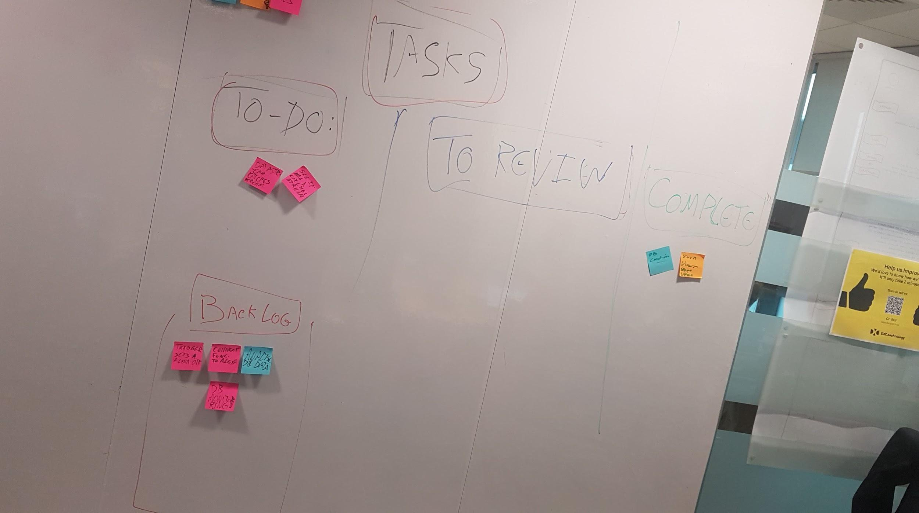
SCRUM Utilisation
Key Positives:
-Initial scrum plan which lead to the creation of the scrum board, which allowed for us to keep track of current progress at all stages of development.
-bi-hourly scrum meetings between sprints to refocus development between sprints, dealing with problems quickly and effectively while also providing soft deadlines which encouraged production.
-Burn down sheet to keep track of task progress, and show which tasks were completed or put onto the backlog again.
-Pushed development forward in an agile manner, that allowed refocus when necessary.
-Scrum reports which documented development in a more detailed manner.
-5 Total scrum reports, 6 sprints

Slide 7
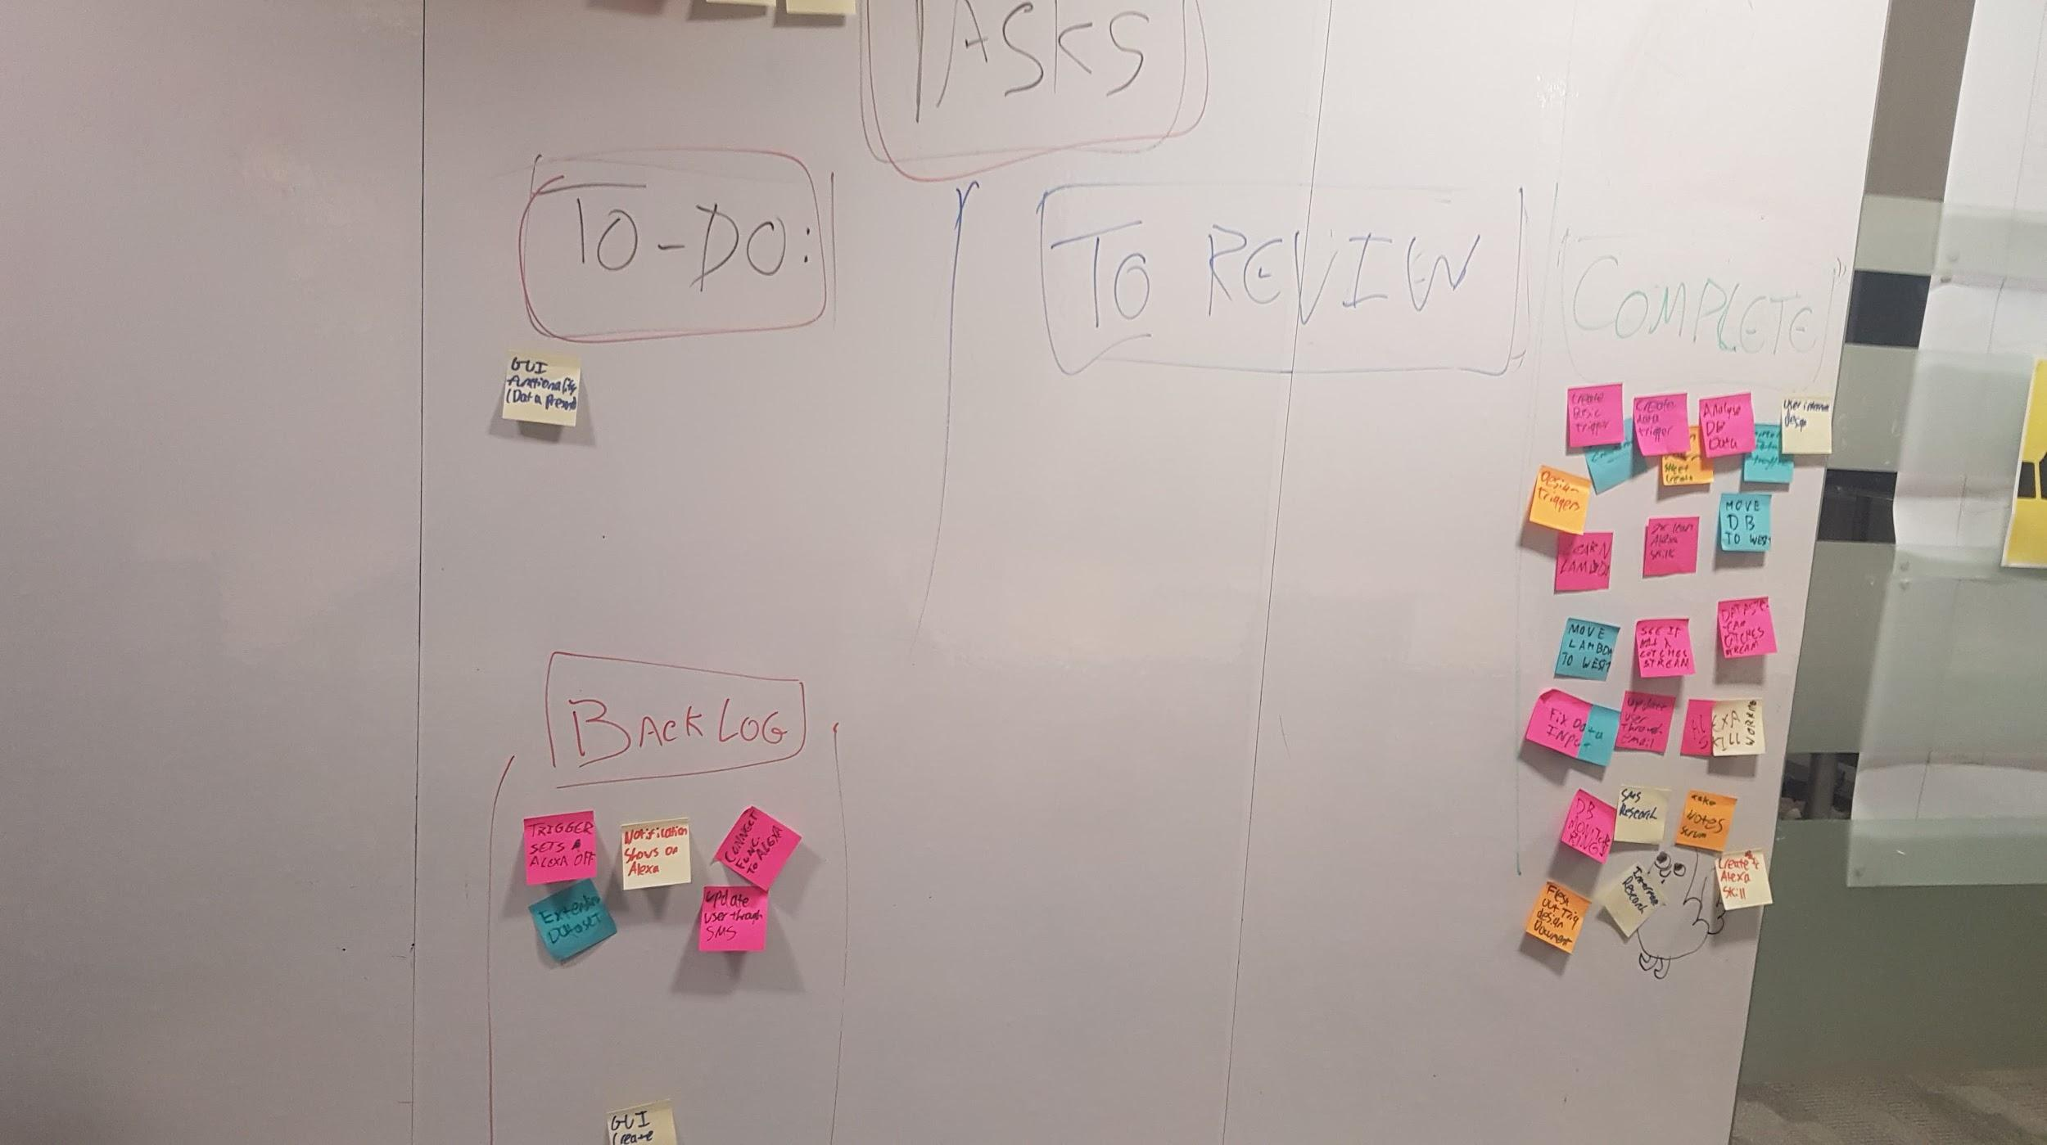
SCRUM CONT
Key issues:
-Lack of client feedback, team didn’t interact with client during any of the scrum, straying from usual scrum practices and leading to a potential stray from the vision of the client
-Scrums sometimes took a greater deal of time than ideal, though due to the nature of the problem this was somewhat unavoidable, as discussion had to go longer.

Slide 8
Part of burndown sheet.
 | Estimated Total hours work | 30 |  | Done | 19.2
Sprint 1 9.30 | Tasks | Expected Time | Spent | Remaining | 1.2
 | Burn Down | 0.1 | 0.1 | 0
 | Take Scrum Notes | 0.1 | 0.1 | 0
 | Learn Lambda | 3 | 2 | 1
 | Learn Alexa Skills | 3 | 2 | 1
 | Find out if lambda catches | 0.1 | 0 | 0.1
 | Fix Oscars Laptop | 1 | 0.1 | 0
 | Database Creation | 1 | 1 | 0
 | Data Stream Setup | 1 | 1 | 1
Full sheet : https://docs.google.com/spreadsheets/d/1xCewPrkm6Yt46Hw0dt8huZKPPdF9iEl46xt_-myZysQ/edit?usp=sharing

Slide 9
Demonstration of MVP

Slide 10
Further Development Ideas
A notification system based on biometric data collected in real time
Utilise sns to create functions that allow E-mail and Text alerts to be sent to carers
Fully functional system
Creation of a comprehensive set of Alexa skills for autism assistance
More carer features, such as an ask how person with autism is at current time

Slide 11
What we have learned
Moving from a weak base level of knowledge to a greater understanding of AWS’ services
Learning to use new SDK’s
Working with a NoSQL database
Working with agile and scrum in a manner using extremely short sprints.
Development of trigger based lambda functions

Slide 12
Conclusions
Now:
-Inability to directly interact with Alexa using normal means
-Growth in terms of skill set, from Agile experience to AWS
-Live simulation of data input
Future:
-Theoretical solution using the Alexa’s music functionality
-Extended Data set, aggregation of values.
-View current diagnostics on desktop GUI

Slide 13

Any Questions?

